Slide 1
From Nearest to Feasible Counterfactual Explanations

Slide 2
Key literature
Introduction of the nearest CFs
Watcher2017: gradient based method
CERTIFAI: genetic method
Difference between CFs and adversarial examples
Freiesleben, T.: Counterfactual explanations & adversarial examples
Including casualty to CFs to obtain feasible CFs
Algorithmic Recourse: from Counterfactual Explanations to Interventions (Karimi et al., 2020)

Slide 3
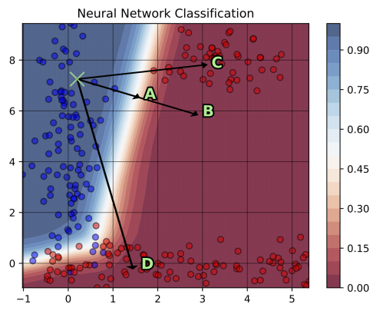
Definition of feasibility?
exceeds the range (user defined)
not presentative in the CF class (data distribution)
not actionable - casualty (e.g. credit score)

